Slide 1
Topic: Measurement EQ: How do I find the perimeter and area of a square?
Year 11 Essentials

Slide 2
Things Required For This Lesson
Interactive Notebook
Textbook: Interleaved Maths Essential Connections
Ruler, Red Pen, Pencil, Pens, Scientific Calculator
Growth mindset

Slide 3

24
7
30
Topic: Measurement
EQ: How do I find the perimeter of squares and rectangles?
WICOR
This Photo by Unknown Author is licensed under CC BY-SA

Slide 4
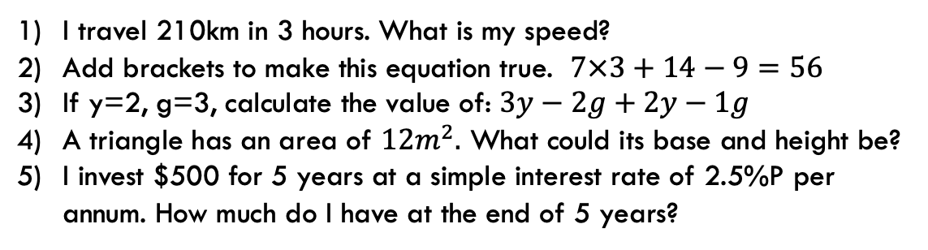
First 5
Answers
1) 70km/h
2) 7(3+14-9)=
3) 1
5) $562.50
I travel 210km in 3 hours. What is my speed?
Add brackets to make this equation true. $7×3+14−9=56$
If y=2, g=3, calculate the value of: $3y−2g+2y−1g$
A triangle has an area of $12m^{2}.$ What could its base and height be?
I invest $500 for 5 years at a simple interest rate of 2.5%P per annum. How much do I have at the end of 5 years?
Answers
4) base(b) 6m, height (h)4m
B:8 H:3, b:12 h:2, b:24 h:1, and in reverse.

Slide 5
24
7
30
Topic: Measurement
EQ: How do I find the perimeter and area of a square?
What is Perimeter?
Is the distance along the boundary of a shape
Some examples:
A fence is built along the perimeter of a property
A soccer pitch has boundary lines along the perimeter
Example:
6cm
Add all the sides together: 6cm+6cm+6cm+6cm= 24cm
Or
A square has 4 equal sides. Multiply the amount of sides with the unit of measurement
4cm x 6cm = 24cm
6cm
6cm
WICOR
6cm

Slide 6
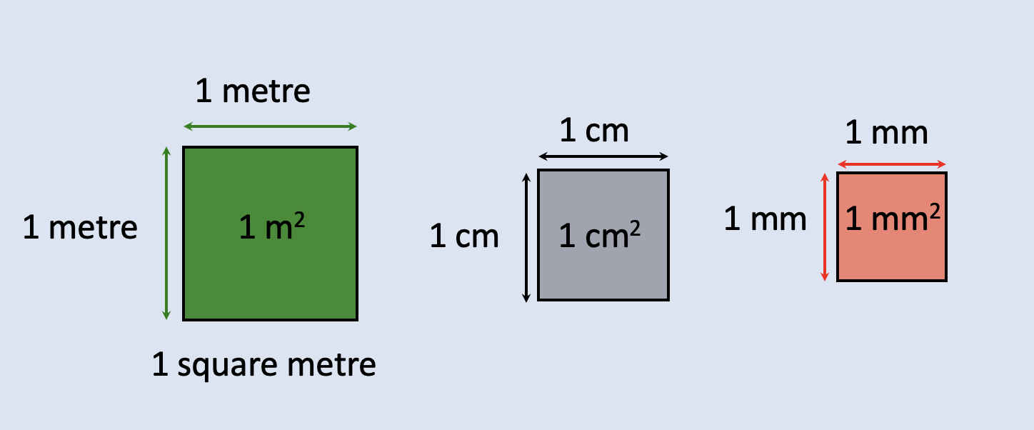
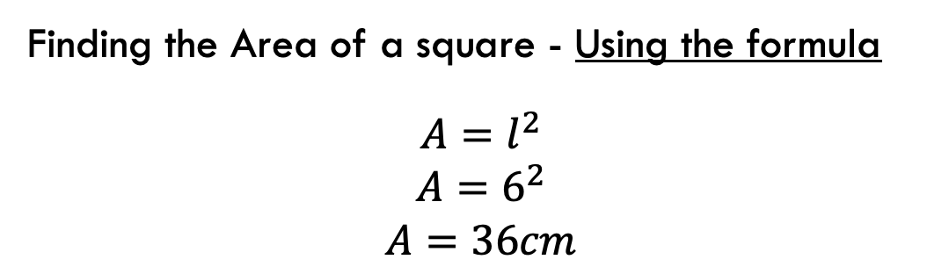
24
7
30
Topic: Measurement
EQ: How do I find the perimeter and area of a square?
Area measures the surface of of 2D shape. It is measured in square units.
What is Area?
Example:
6cm
Finding the Area of a square - Using the formula
$$A=l^{2}$$
$$A=6^{2}$$
$$A=36cm$$
6cm
6cm
WICOR
6cm

Slide 7
Practise
Using grid paper complete the experiment on page 64.
Square | Base length | Height | Area enclosed | Pattern or Formula
A
B
C
D
E

Slide 8
Practise
Area of Squares worksheet.

Slide 9

Thank you
Keep up the good work!
Quote of the day – ”Make today awesome, so that yesterday gets jealous.”

